Slide 1

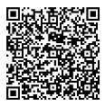
Microcredit Experiences for Sustainable Agriculture
Apresentação:

Slide 2

Our mission is to provide excellent financial solutions through relationships to generate development for our members, their businesses, and the community!
Notes:
Juntar os dois quadros laranjas

Slide 3
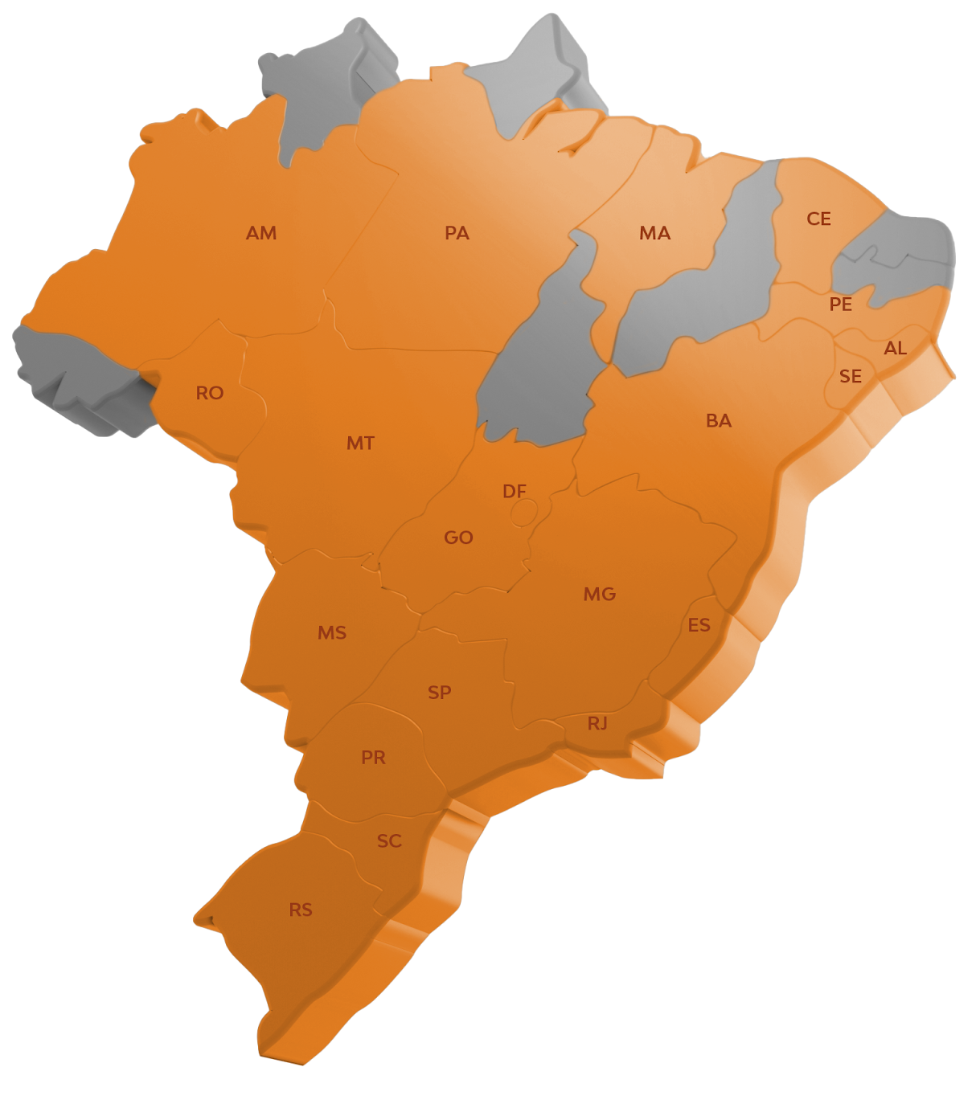





National Presence
1 million members
59 – Cooperatives
998 – Branches
19 – States
4.092 – Municipalities with members
Notes:
Juntar os dois quadros laranjas

Slide 4
Cresol System
Assets
49,8 bi
R$
R$
R$
Financial results
805 mi*
Sustainable Credit Portfolio
12 bi
Employees
+ 11 thousand
Women Members
39%
Young Members
23%
Dados referentes a setembro de 2025.
*Dados referentes a dezembro de 2024.
Notes:
Juntar os dois quadros laranjas

Slide 5

7,6 bi
R$
+117K approved contracts
*Fiscal Year 2024
+ 272k ha no-till farming
Environmental compliance: Mapbiomas + Agrotools
Notes:
Juntar os dois quadros laranjas

Slide 6

Objective: To support sustainable infrastructure, sanitation, and water management projects
Aligned with ESG principles and the UN SDGs (6, 11, and 13)
More than 3,000 people impacted and 1,600 loans approved
R$ 92 million financed in water use and sanitation improvements
Notes:
Juntar os dois quadros laranjas

Slide 7
Cresol’s Sustainable Portfolio
R$ 12 billion (Active Portfolio) allocated with contribution to the Green Economy;
Portfolio classified according to Febraban guidelines;
The classification monitors: Green Economy, Exposure to Environmental Risk, and Exposure to Climate Change
We adopt a proactive approach to mitigate impacts and drive positive change
We recognize the influence of climate change on the products and services offered to our cooperative members
Notes:
Juntar os dois quadros laranjas

Slide 8

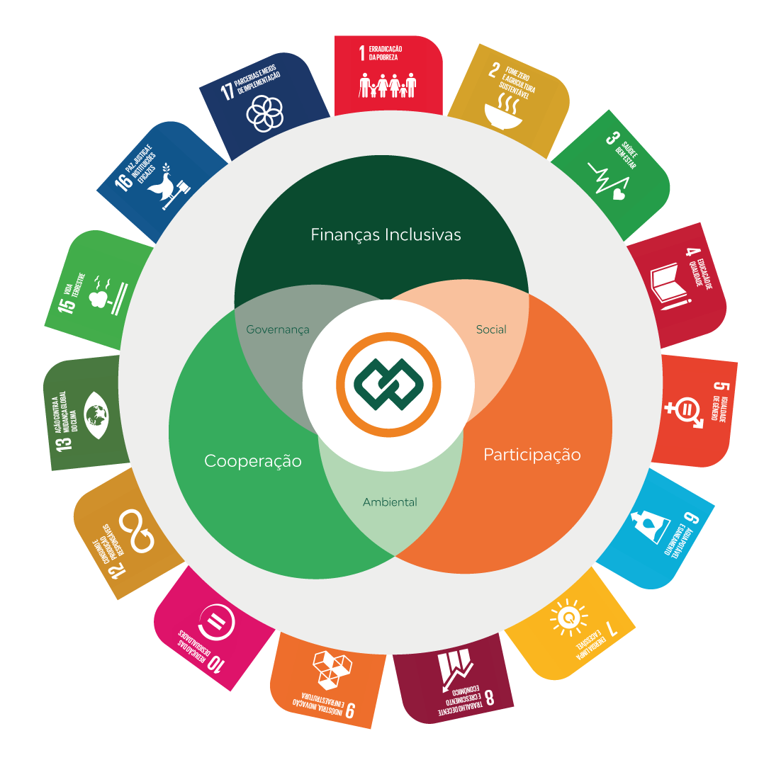
Sustainability Strategy
15 SDGs impacted
Over 90 ESG indicators
Sustainability Committees
ESG Action Plan
Sustainability Policy
UN Global Compact
UN “Educa 2030” Movement
UN “Mente em Foco” Movement
51,000 people reached through Financial Education initiatives
32,000 children and youth engaged in Educational Projects
Projects focused on women and entrepreneurs
Notes:
Juntar os dois quadros laranjas

Slide 9
Enterprises Supported by Cresol
The segments are divided into micro, small, medium, and large enterprises
We remain firmly committed to supporting micro, small, and medium-sized businesses, with an average loan amount of R$ 40,652.68 per operation.
The funding sources for these businesses come from the Brazilian Development Bank (BNDES), Rural Credit programs, and Cresol’s own resources.
We are recognized as the institution with the highest number of operations carried out through BNDES.
Data-base dos dados: Dezembro de 2024.
Business Size | % by segment
Micro | 20,81%
Small | 44,38%
Medium | 26,85%
Large | 7,96%
Notes:
Juntar os dois quadros laranjas

Slide 10
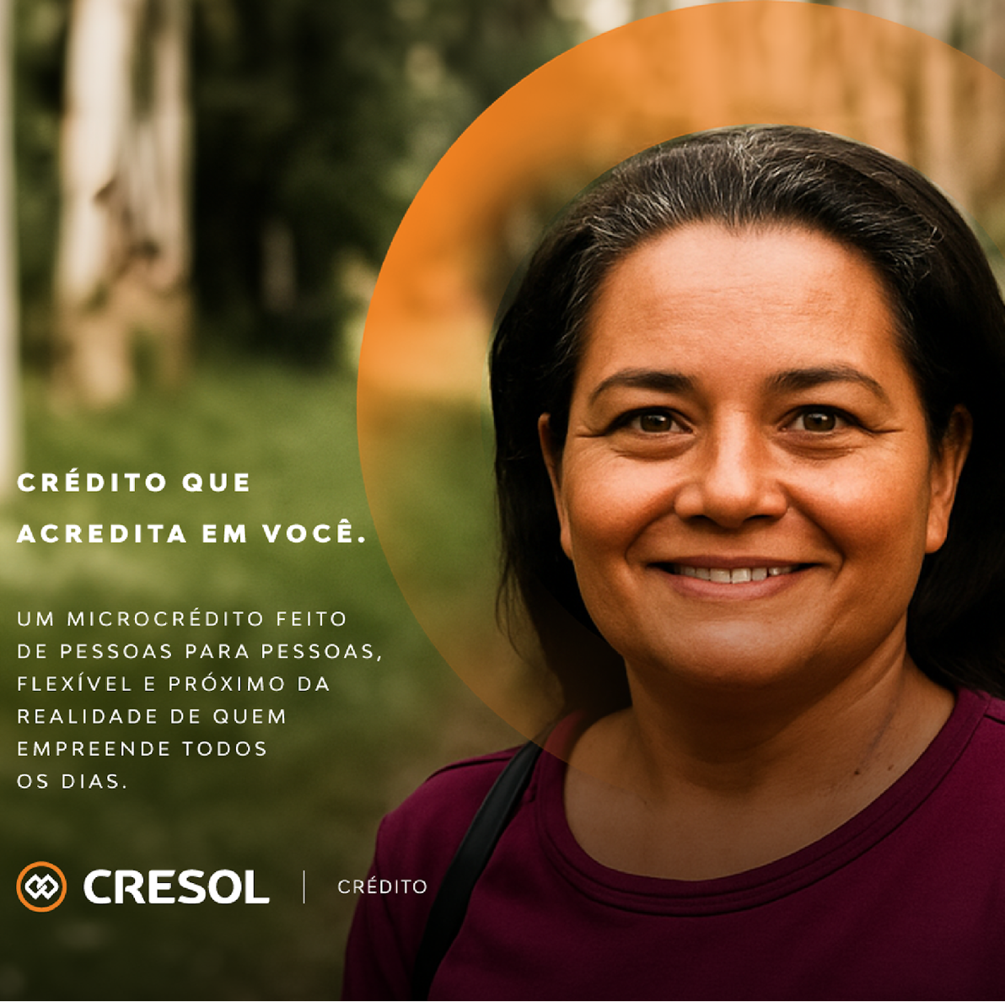

CRESOL ATIVABIO
LAUNCH
Microfinance for the Amazon Bioeconomy
A member journey adapted to local realities
8,000 new members
+ R$ 320 million in Cresol’s microfinance portfolio
Primarily serving participants in the bioeconomy sector.

Slide 11
Thank you!
Jaap van Waalwijk van Doorn
International Relations Manager- Cresol Instituto
Apresentação:

